Slide 1
E PROJECT:
Alpine Ascents
DOCUMENTATION
Presented by Alpine Ascents

Slide 2
PROJECT GROUP MEMBERS:
Students Name | Students Id
Burhan Mustafa | Student1729324
Abdullah Memon
M. Moiz
FACULY NAME: SIR.MAAZ RAHIM
CO-ORDINATOR NAME: Ashna Nasir

Slide 3
CERTIFICATE:
This is to certify that the dissertation entitled
“Alpine Ascents”
has been successfully carried out by
Alpine-Ascents-Group
in partial fulfilment of the requirements for the award of the Aptech Computer Certification.

Slide 4
ACKNOWLEDGEMENT:
The successful completion of this project, “ALPINE ASCENTS”, would not have been possible without the guidance, encouragement, and support of many individuals.
I express my sincere gratitude to Aptech Institute for giving me the opportunity to work on this project and for providing constant support and resources throughout the process. Their vision of enhancing education through technology inspired me to practically implement the concepts learned.
I would like to extend my deepest appreciation to my project guide, whose expert guidance, insightful feedback, and constant motivation helped me complete this project successfully. Their valuable suggestions played a crucial role in shaping the project into its present form.
I also acknowledge the support of my colleagues, friends, and family who encouraged me during the course of this project and provided helpful suggestions whenever needed.
Finally, I owe my gratitude to all those who directly or indirectly contributed to the successful completion of this project.

Slide 5
ABSTRACT:
Alpine Ascents International is a premier mountaineering and adventure guiding company recognized globally for leading expeditions to the world's most iconic peaks, including Mount Everest, Mount Rainier, and Aconcagua.
Founded on a philosophy of rigorous safety, comprehensive preparation, and environmental stewardship, the organization sets the industry standard by employing some of the most elite, certified mountain guides in the field.
Beyond simply reaching summits, Alpine Ascents is renowned for its thorough mountaineering schools and training courses that equip climbers with the technical skills, physical conditioning, and mental resilience required to navigate extreme high-altitude environments safely.
By balancing bold expeditions with a deep commitment to sustainable travel and local mountain communities, the company has built a legacy of transforming passionate outdoor enthusiasts into capable, self-reliant mountaineers who respect the power and fragility of the natural world.

Slide 6
PROBLEM STATEMENT:
Many aspiring mountaineers and outdoor enthusiasts are drawn to the thrill of high-altitude climbing through romanticized media, often underestimating the severe physiological risks, sudden weather shifts, and technical complexities involved.
Without an accessible, interactive, and educational platform that openly details these hazards, beginners risk entering extreme environments ill-prepared. This project addresses that gap by providing an immersive, data-driven web portal that balances the adventure of mountaineering with rigorous risk education, safety protocols, and structured preparation tools.
Also features upcoming Expeditions that will be hosted by Alpine Ascents Pakistan. First Educate than Fun.
Customer Specifications:
Website will host information about common Risks, Preventions and Pre-measures. It will also display the latest news and information on nearly expected expedition.

Slide 7
KEY FEATURES
Interactive Hero Section: Features a dynamic image carousel built with JavaScript and jQuery to create an
immersive, high-altitude visual experience right upon landing.
Balanced Educational Focus: Explicitly addresses both the thrilling adventure and the critical safety realities, dangers, and physiological risks of mountaineering.
Comprehensive Risk Breakdown: Educates users on high-altitude hazards such as crevasse falls, acute mountain sickness (AMS), and sudden weather shifts.
Expedition Tier Filtering: Allows aspiring climbers to explore various climbs categorized by difficulty levels (Beginner, Intermediate, Extreme) to understand progressive skill building.
Interactive Survival Checklist: A jQuery-powered tool that lets users check off essential survival gear like crampons,
ice axes, and specialized layers before an expedition.
Lightweight Tech Stack: Developed purely using core web technologies (HTML5, CSS3, JavaScript, Bootstrap and jQuery) without relying on heavy frontend frameworks.
Responsive & Accessible Design: Crafted with clean CSS layout principles and relative file structures ensuring
smooth performance across different screen sizes.
Offline Asset Management: Optimized with local image asset paths (images/photo-no.avif)
User Value & Benefit: Equips beginners and outdoor enthusiasts with essential knowledge, safety protocols,
and preparation tools to prevent ill-prepared expeditions.
Institute Project Friendly: Designed as a structured, easy-to-explain portfolio piece that demonstrates practical
DOM manipulation, event handling, and modern UI design.

Slide 8
USER-PANEL

Slide 9
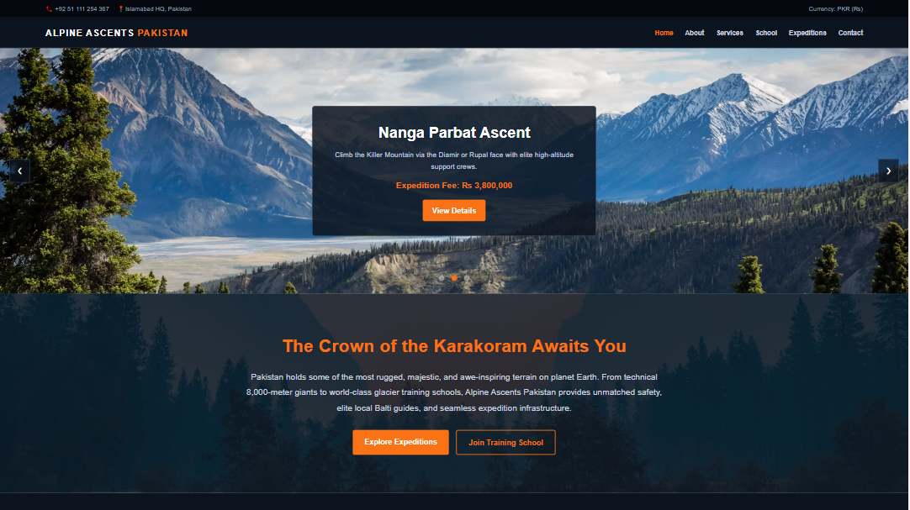
HOME:

Slide 10
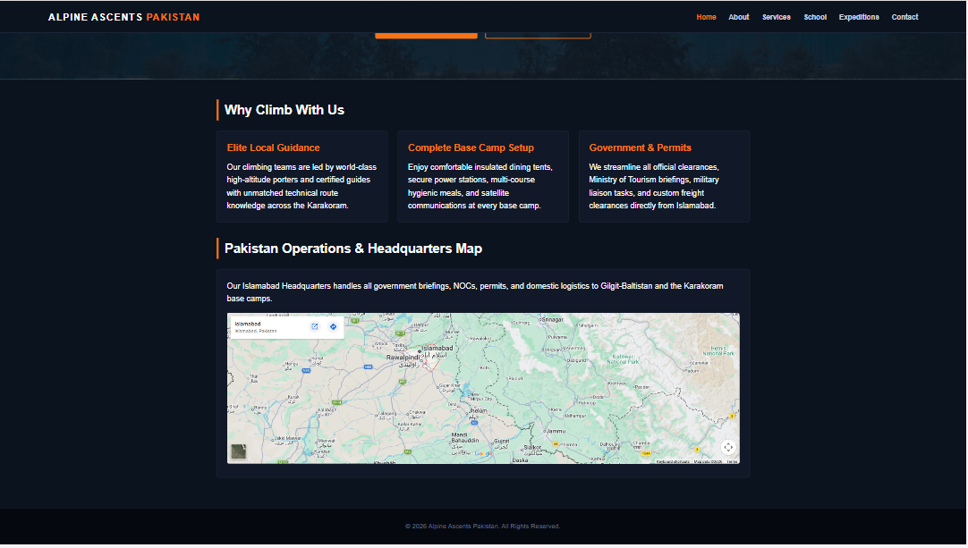

Slide 11
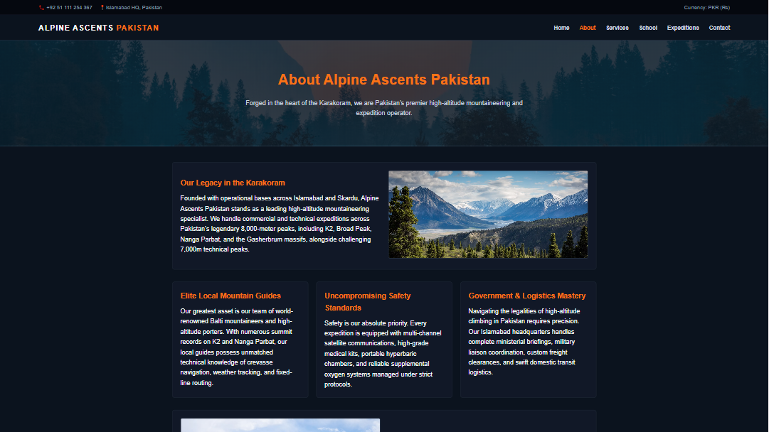
ABOUT US :

Slide 12
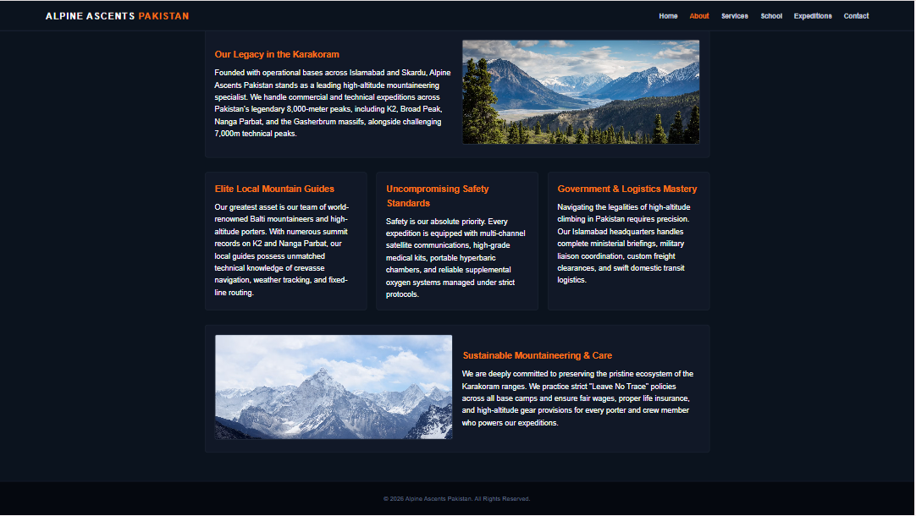

Slide 13
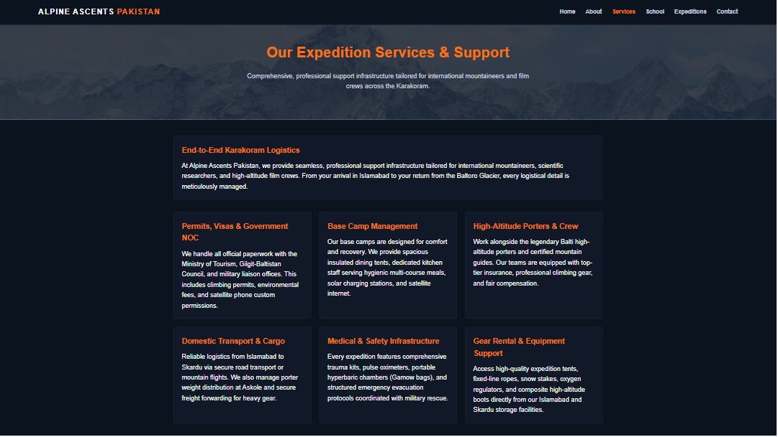
Services:

Slide 14
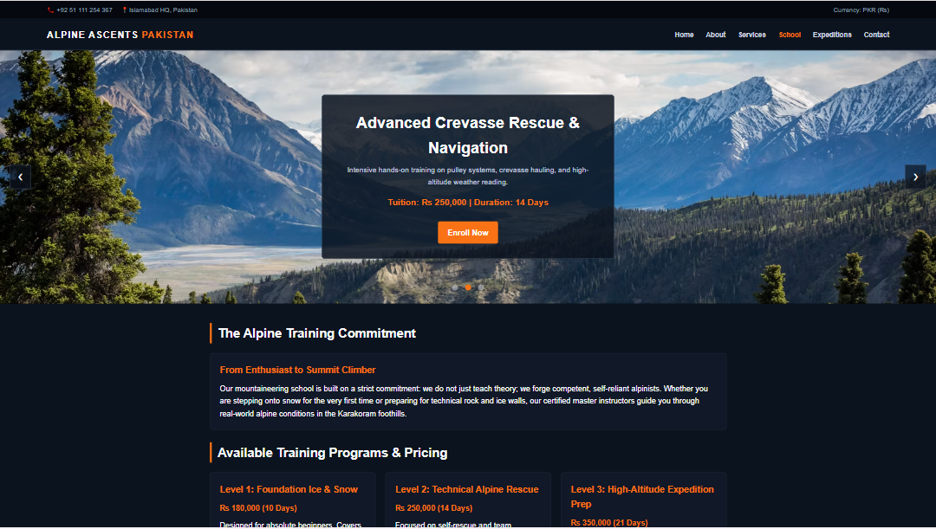
School:

Slide 15
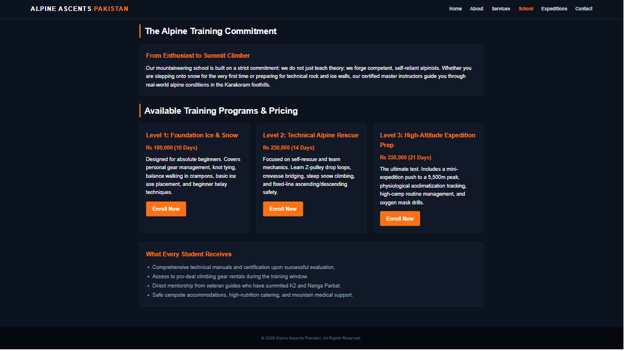

Slide 16
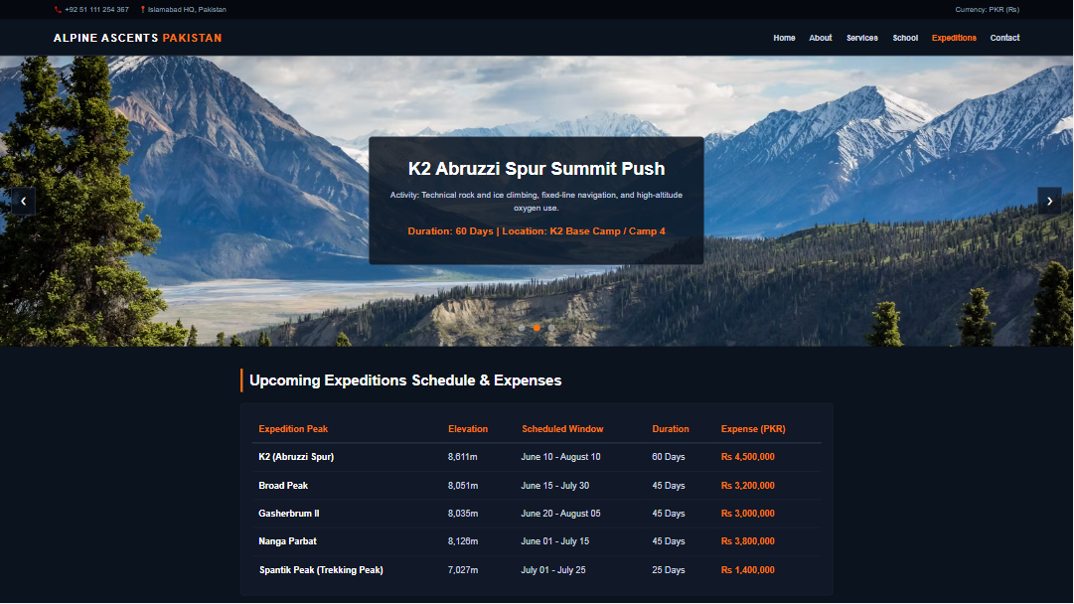
Expeditions:

Slide 17
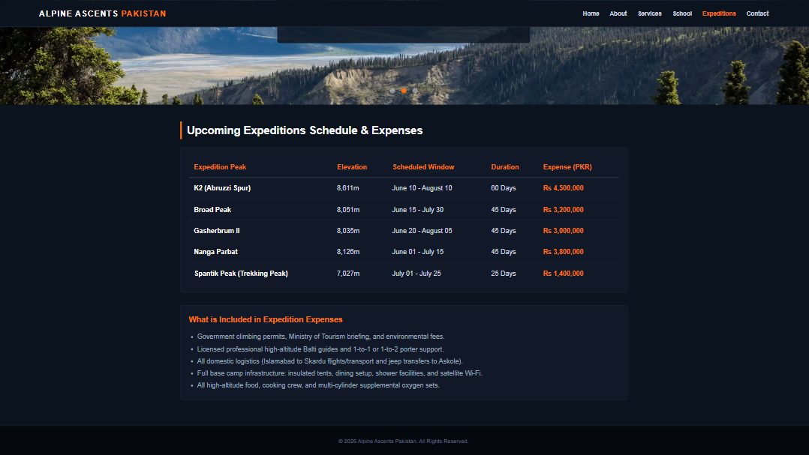

Slide 18
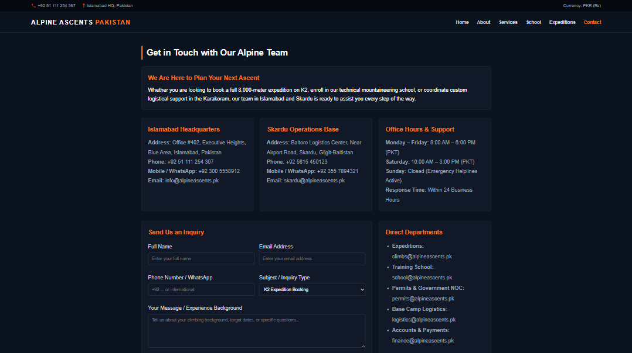
CONTACT US :

Slide 19
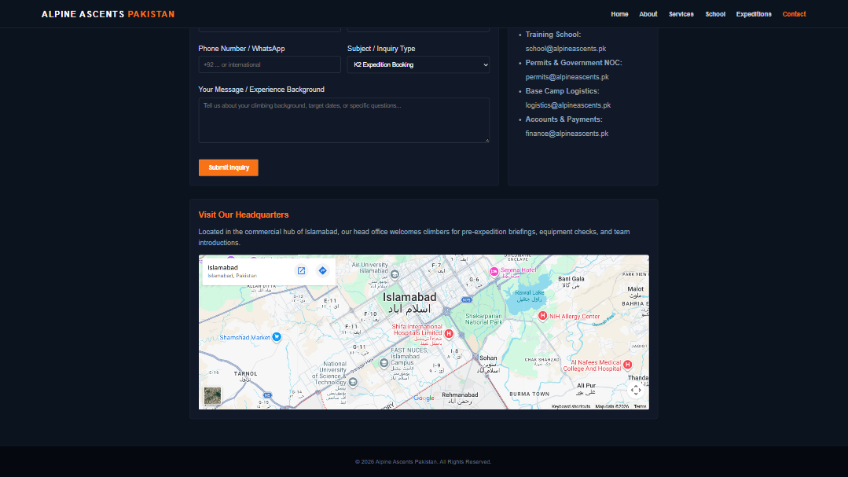

Slide 20
THANK-YOU
Regards,
Team Alpine Ascents.

